Slide 1
Azure ARM Template Terraform
Daniel Wang – Cloud Solutions Architect

Slide 2
Agenda Overview
Estimated availability: CY17 Q1 (Public Preview)
Azure Resource Manager
ARM Template Overview
Template areas
Authoring
Portal (exporting)
Advance features
Linked
Terraform Overview
ARM / Terraform Comparison
Dev Ops ARM / Terraform

Slide 3
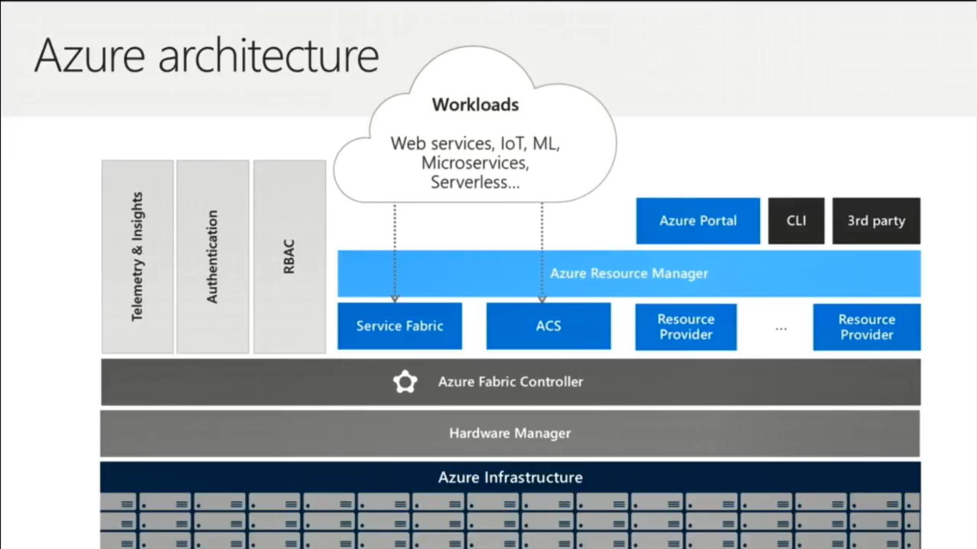

Slide 4
ARM
Estimated availability: CY17 Q1 (Public Preview)

Slide 5
Azure Resource Manager Templates (ARM)
ARM template – A JSON template that deploys resources to a resource group using a declarative syntax through a resource provider.
ARM templates are Azure’s Infrastructure as Code (IaC)
Allows for ”some” configuration. ARM templates are NOT configuration!
You can call Virtual Machine extensions for configuring IaaS
You can still use DSC, Puppet, Chef to perform configuration
Packer can be used to create fully initialized images
ARM templates are idempotent – you can run over and over. You should keep these in source control and be part of your Dev Ops release pipelines. To rollback to a prior version, just deploy the prior ARM template
Resource dependencies – creates the resources in the correct order
Samples: https://aka.ms/armtemplates
Building Blocks: https://github.com/mspnp/template-building-blocks
ARM templates are not for “classic” Azure deployments

Slide 6
ARM – Sections of a template
{
"$schema": "http://schema.management.azure.com/schemas/2015-01-01/deploymentTemplate.json#",
"contentVersion": "",
"parameters": { },
"variables": { },
"functions": [ ],
"resources": [ ],
"outputs": { }
}

Slide 7
ARM – Sections of a template
$schema – location of JSON schema
contextVersion – The version of the template
parameters – values for the template. Theses do not have to be provide, they can be provided via a external parameters.json file or they can be provided command line. They can provide restrictions like allowed values, default valuts, min and max lengths along with metadata for a description. Parameters can be objects.
Command line (inline) parameters take precedence over the ones in the template file
You cannot use command line and an external parameters JSON file at the same time
Parameters can be string, secureString, int, boolean, object, secureObject, array
variables – values that can be used in your template
functions – there are built in functions and you create own (usually used to reduce complicated expressions)
resources – the Azure resources to be deployed
outputs – items that are returned from the deployment

Slide 8
ARM Deployment Modes
Complete
Resources are deployed and existing resources in the resource group that are not included in the template are deleted.
Incremental
Resources are deployed without deleting existing resources that are not included in the template
Verification (not “technically” a mode)
Test your template and parameter values without actually deploying any resources CHECK: On if this will show a delta plan.
az group deployment validate

Slide 9
ARM – Linked template
https://docs.microsoft.com/en-us/azure/azure-resource-manager/resource-group-linked-templates
You can link your templates together instead of building one monolithic template
Dependencies cross templates: "[reference('<name-of-deployment>').outputs.<property-name>.value]"
Output variables can be used "dependsOn": [ "linkedTemplate" ]
"resources": [
{
"apiVersion": "2017-05-10",
"name": "linkedTemplate",
"type": "Microsoft.Resources/deployments",
"properties": {
"mode": "incremental",
"templateLink": {
"uri":"https://.../myTemplate.json",
"contentVersion":"1.0.0.0"
},
"parametersLink": {
"uri":"https://.../myParameters.json",
"contentVersion":"1.0.0.0"
}
}
}
]
Single Template
Linked Template
Storage
SQL Database
Databricks
Storage
Main
SQL Database
Databricks

Slide 10
ARM Azure Portal
Resource Group Automation: Reverse Engineering
The export does not always export all resources:

Slide 11
ARM Deployment
Portal – JSON templates (sharing)
Azure Dev Ops
REST API
PowerShell
Azure CLI
.NET
Java
Ruby
Node.js
Etc.
az group deployment create \
--name MyName
--resource-group MyResourceGroup \
--location eastus \
--template-file template.json \
--parameters @parameters.json
New-AzureRmDeployment `
-Name MyName `
-ResourceGroupName MyResourceGroup `
-Location eastus `
-TemplateFile template.json `
-TemplateParameterFile parameters.json

Slide 12
ARM Dependencies
dependsOn - lets you control the order in which resources are created. This can also affect how much parallelism you get from your template. You can have dependencies on multiple resources.
Child resources – resources defined within a resource up to fix level deep. These are part of the same “namespace” of the parent resource. You need to have a dependency between the two resources to control the deployment order.
Referencing – If a resource references (“reference function”) the name or output of another resource a dependencies is created.

Slide 13
ARM Conditions
Conditionals – allow you to controls if a resource (level) is created during the deployment of the ARM template.
Uses
Skip creating a resource
Create two of the same resource, but configure differently. For example if you have a private web app you might want a certain setup versus a public web app.
Some customers use conditions instead of nested ARM templates for conditions
condition": "[equals(parameters('MyParameter'),'OptionA')]"

Slide 14
ARM Functions
ARM Functions (built in): https://docs.microsoft.com/en-us/azure/azure-resource-manager/resource-group-template-functions
Custom Functions:
"functions": [
{
"namespace": "myMainTemplateNamespace",
"members": {
"generateUniqueName": {
"parameters": [
{
"name": "myName",
"type": "string"
}
],
"output": {
"type": "string",
"value": "[concat(toLower(parameters('myName’)),
uniqueString(resourceGroup().id))]"
}
}
}
}
]

Slide 15
ARM Outputs
Send output out of the ARM deployment process
You can view these values in the portal
You can view with CLI / PowerShell
"outputs": {
"AzureWebAppHost": {
"type": "string",
"value": "[reference(variables('webSiteName')).defaultHostName]"
}
}
az group deployment show \
--resource-group MyResourceGroup \
--name MyDeploymentName \
--query properties.outputs.resourceID.value

Slide 16
ARM KeyVault Integration
You can deployment templates with key vault (only as parameters)
https://www.linkedin.com/pulse/accessing-key-vault-secrets-from-arm-templates-paul-towler/
"MY-ARM-PARAMETER-NAME": {
"reference": {
"keyVault": {
"id": "/subscriptions/<<SUBSCRIPTION-ID>>/resourceGroups/<<RESOURCE-GROUP>>/
providers/Microsoft.KeyVault/vaults/<<KEY-VAULT>>"
},
"secretName": "MY-SECRET-NAME-IN-KEY-VAULT"
}
}

Slide 17
ARM Copy Command / Complex Types
ARM can create multiple instances of resources in a loop
Parameters can be JSON: https://docs.microsoft.com/en-us/azure/architecture/building-blocks/extending-templates/objects-as-parameters
Reference for each ARM resource: https://docs.microsoft.com/en-us/azure/templates/

Slide 18
ARM Editors
VS Code
Install: https://marketplace.visualstudio.com/items?itemName=msazurermtools.azurerm-vscode-tools
Copy this: https://raw.githubusercontent.com/Azure/azure-xplat-arm-tooling/master/VSCode/armsnippets.json
Paste into File -> Preferences -> User Snippets -> JSON
Type arm- “ctrl+space”
Visual Studio
Buid your template through wizards
Tip: Start at a low level and work your way up to larger objects (e.g. build VNETs and Storage first)

Slide 19
ARM Tips / Tricks / Problems
ARM templates can get really big and really confusing, you should break apart into separate linked templates
ARM template do have a comment field (that helps for documenting)
Deploy an empty ARM template to “delete” all resources. This will clear out a resource group which is important when you want to save your RBAC permission on the resource group.
You can reference an HTTPS address. Customers will place their templates in blob storage, create a SAS token and then call (if they are not doing Dev Ops).
Errors are not always obvious (template could fail due to quota).
“Borrow” as much as you can from other templates online.
Keep any SAS tokens with a short expiration (you can see the ARM URLs in the portal)
ARM templates are used for Azure Blueprints: https://docs.microsoft.com/en-us/azure/governance/blueprints/overview
You can deploy to multiple resource groups and subscriptions: https://docs.microsoft.com/en-us/azure/azure-resource-manager/resource-manager-cross-resource-group-deployment
Not every region contains every Azure service
Check the Activity Log for errors
Use the –rollback-on-error flag to rollback
Like YAML? https://blog.mexia.com.au/writing-arm-templates-in-yaml https://github.com/TeamYARM/YARM-CLI

Slide 20
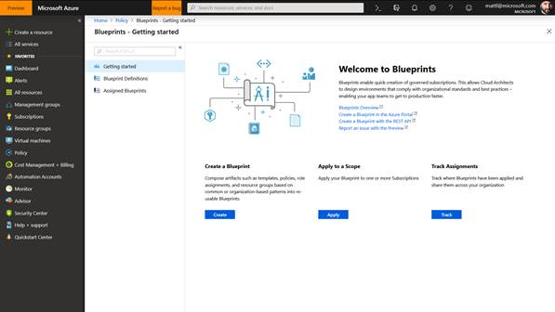
Azure Blueprints
Public Preview
Released @ Ignite
Sept 2018
Streamline environment creation
Easily deploy your resource templates, policies, and access control so environments are ready to start using right away.
Enable compliant development
Speed deployment of compliant applications to production through a self-service model
Lock foundational resources
Limit access to key infrastructure that’s shared across subscriptions to prevent unwanted changes
Documentation
Product Page
Blog URL

Slide 21
Terraform
Estimated availability: CY17 Q1 (Public Preview)

Slide 22
Terraform
Terraform is an orchestration tool for provisioning cloud resources
Terraform is multi-cloud (Azure, AWS, on-prem)
Terraform uses state files
Terraform is NOT configuration!
You can call Virtual Machine extensions for configuring IaaS
You can still use DSC, Puppet, Chef to perform configuration
Packer can be used to create fully initialized images
Terraform uses HashiCorp Configuration Language (HCL)
Terraform recovers from transient errors
Terraform has many providers: https://www.terraform.io/docs/providers/index.html
Samples: https://github.com/terraform-providers/terraform-provider-azurerm/tree/master/examples
Azure Resources supported: https://www.terraform.io/docs/providers/azurerm/
Azure / Terraform Q&A: https://open.microsoft.com/2018/01/04/top-questions-about-terraform-and-azure/

Slide 23
Terraform Commands
terraform init – initialize state
terraform validate – validate your templates
terraform plan – plan your deployment, see what will occur
terraform apply – execute the deployment
terraform destroy – delete your deployment

Slide 24
Terraform Structure of file
terraform {
backend "azurerm" {
storage_account_name = "samplebase”
container_name = "<Name_of_the_storage_container>"
key = "remotestatetest.tf"
container_name = "terraform"
access_key = "<<REMOVED>>"
}
}
provider "azurerm" {
subscription_id = "<<REMOVED>>"
client_id = "<<REMOVED>>"
client_secret = "<<REMOVED>>"
tenant_id = "<<REMOVED>>"
}
resource "azurerm_resource_group" "default" {
name = "${var.resource_group_name}"
location = "${var.location}"
}
resource "azurerm_app_service_plan" "default" {
name = "${var.app_service_plan_name}"
location = "${azurerm_resource_group.default.location}"
resource_group_name = "${azurerm_resource_group.default.name}"
sku {
tier = "${var.app_service_plan_sku_tier}"
size = "${var.app_service_plan_sku_size}"
}
}

Slide 25
Terraform Variables
Variables can be used throughout the main template
Variables can be set in files (tf) file
Variables can be set in a (tfvar) file
Variables can be set via command line
String variables can be read from environment variables
Terraform can also prompt you for variables
variable "resource_group_name" {
type = "string"
description = "Name of the azure resource group."
default = "AppResourceGroup"
}
resource_group_name=TestRG
terraform apply –var "resource_group_name=TestRG"
"TF_VAR_resource_group_name"

Slide 26
Terraform Combining Templates / Variables
Terraform loads all the ”.tf” files in the current directory
Terraform loads the terraform.tfvars file and/or *.auto.tfvars files in the current directory
NOTE: Do not use both a .tf and .tfvars in the same directory. Terraform will get confused.
Variables have precedence
Command line
From files (order of files matters)
Environment Variables
UI Input

Slide 27
Terraform Outputs
Outputs can be specified
Outputs can be queried after a run using the terraform output <<output name>>
output "app_service_default_hostname" {
value = "https://${azurerm_app_service.default.default_site_hostname}"
}
./terraform output app_service_default_hostname

Slide 28
Terraform State
You must initialize the Terraform State
This can be done for ”all” of your infrastructure (rollbacks can be big / scary). You can also have state per resource group / application. Workspaces should be used to help separate application and environment boundaries.
Remote state should use Azure Blob Storage. Keeping state on a local machine is a big concern. The Pro / Premium Enterprise editions of Terraform provide a state server as well.
You can have people competing over getting a lock to the state file
NOTE: Secrets can be written to your state file
./terraform init

Slide 29
Terraform Plan / Apply
Terraform plan will show you what Terraform will perform
Plans use
+ resource will be created
- resource will be destroyed
~ resource will be updated in place
-/+ resource will be destroyed and re-created
Terraform apply runs the deployment
If you generate a plan and the state changed, you need a new plan. You need to do some extra steps to run this plan on a different machine.
./terraform plan
./terraform apply
./terraform plan –out myplan
./terraform apply -input myplan

Slide 30
Terraform Import
You can import existing resources
You currently need to import each resource one by one
You must start with an empty template
You import each resource one by one
You have to update your TF file by hand
./terraform import

Slide 31
Terraform Loops / If statements / For
Terraform can do Loops (like ARM count) to create many of the same resources
Terraform can do basic if..then tests.
Terraform can do For loops
Built in Functions: https://www.terraform.io/docs/configuration/interpolation.html
"${var.env == "production" ? var.prod_subnet : var.dev_subnet}"

Slide 32
Terraform Other Features
Modules – create reusable group of resources
KeyVault – use secrets from Azure Key Vault: https://www.terraform.io/docs/providers/azurerm/r/key_vault.html
Run ARM templates: https://github.com/terraform-providers/terraform-provider-azurerm/blob/master/examples/encrypt-running-linux-vm/main.tf
Run VM Extensions (commandToExecute): https://github.com/terraform-providers/terraform-provider-azurerm/blob/f1403facda37e529208d284f874a25bbbac0b14a/examples/vm-custom-image-new-storage-account/main.tf

Slide 33
Terraform Editions

Slide 34
Terraform / Microsoft
Terraform is getting more and more support
Terraform is installed in Azure Cloud Shell by default
Corey Sanders (Partnership): https://azure.microsoft.com/en-us/blog/investing-deeply-in-terraform-on-azure/
ARM Templates can use Terraform providers for (Kubernetes, Cloudflare and Datadog) https://azure.microsoft.com/en-us/blog/introducing-the-azure-terraform-resource-provider/

Slide 35
Dev Ops
Estimated availability: CY17 Q1 (Public Preview)

Slide 36
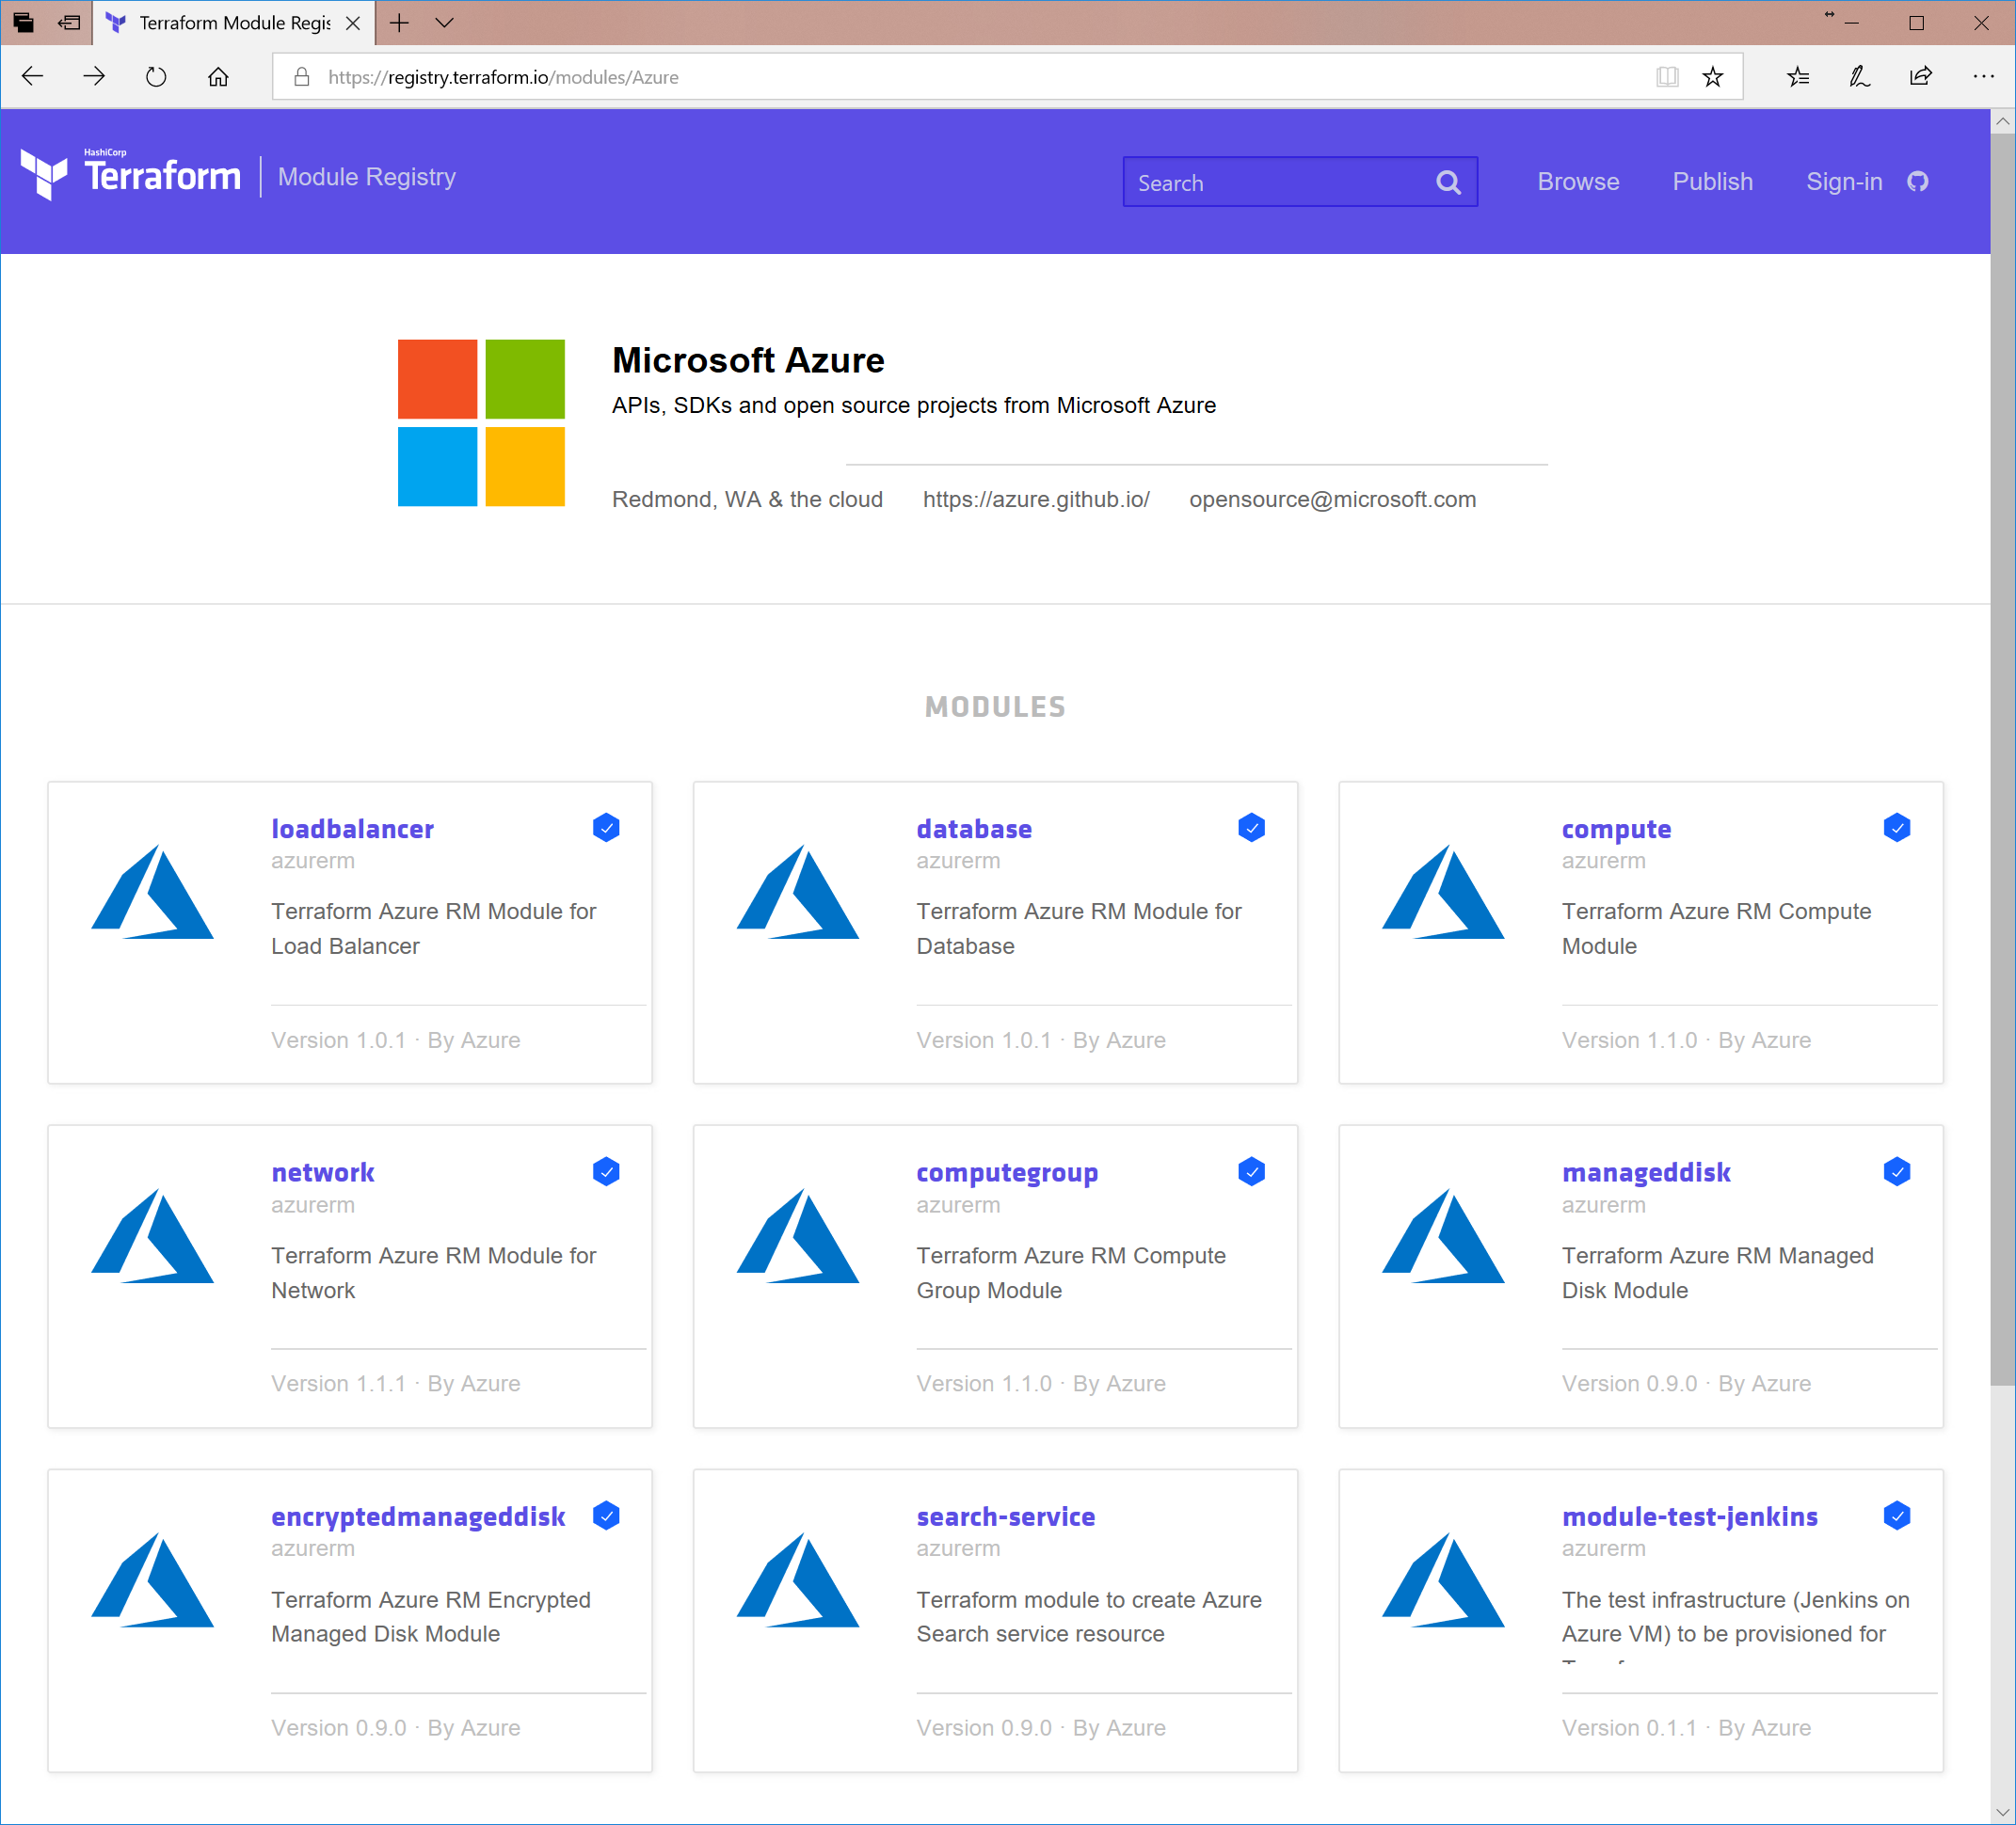
DevOps Integrations - Terraform
Bringing native Azure support to customers using Terraform
Documentation Hub for Terraform
Terraform in Azure Cloud Shell
Azure Resource Provider
Azure Module Registry https://registry.terraform.io/modules/azure
Azure Cloud Shell Integration
https://docs.microsoft.com/en-us/azure/terraform/
Notes:
Hashicorp Terraform is an open source tool for provisioning and managing cloud infrastructure. It codifies infrastructure in configuration files that describe the topology of cloud resources, such as virtual machines, storage accounts, and networking interfaces. Terraform's command-line interface (CLI) provides a simple mechanism to deploy and version the configuration files to Azure or any other supported cloud.
Microsoft is building out native Azure support into the Terraform open source project to simplify deploying and using Terraform on Azure for our customers.

Slide 37
Comparison
Estimated availability: CY17 Q1 (Public Preview)

Slide 38
Feature Comparison
Feature | ARM | Terraform
Infrastructure as Code (IaC) | Yes | Yes
Readability | JSON | HashiCorp Config Language (HCL)
Execution plans | No | Yes
Dependencies | Yes (Explicit) | Yes (Implied)
Multi-Cloud | No | Yes
Configuration | Limited | Limited (can do some storage tasks)
Rollback State | Yes – deploy prior template / rollback | Yes – maintains state
Azure Preview features | Yes | Yes – inline ARM snippets
KeyVault support | Yes | Yes
Corrupted State | State not needed | Can be an issue
Supports Dev Ops | Yes | Yes
Cost / Support | Free, uses Azure support | Free / Paid (purchase support)
Parallel deployments | Yes | Yes

Slide 39
Feature Comparison
Feature | ARM | Terraform
Runs “Locally” | ARM template is uploaded / deployed in Azure | Terraform uses REST calls via a client machine
Delete resource in portal and not worry about state | Yes | No
Support Comments | Via an Attribute | Yes including block comments
Speed | Can take a while | Can be fast since it can deploy just a single item based upon its plan
Math Functions | Yes | Yes
Count / Loops | Yes | Yes
Sub-Templates/Modules | Yes – Linked Templates | Yes – Modules
Deploy to multiple resource groups | Requires many template | Can be done in one template
Reference existing resources | Variable w/resource id path | “data” resource type
Reverse Engineer resources | Export and Visual Studio | Object by Object by importing

Slide 40
Feature Comparison (Syntax Difference)

